Slide 1
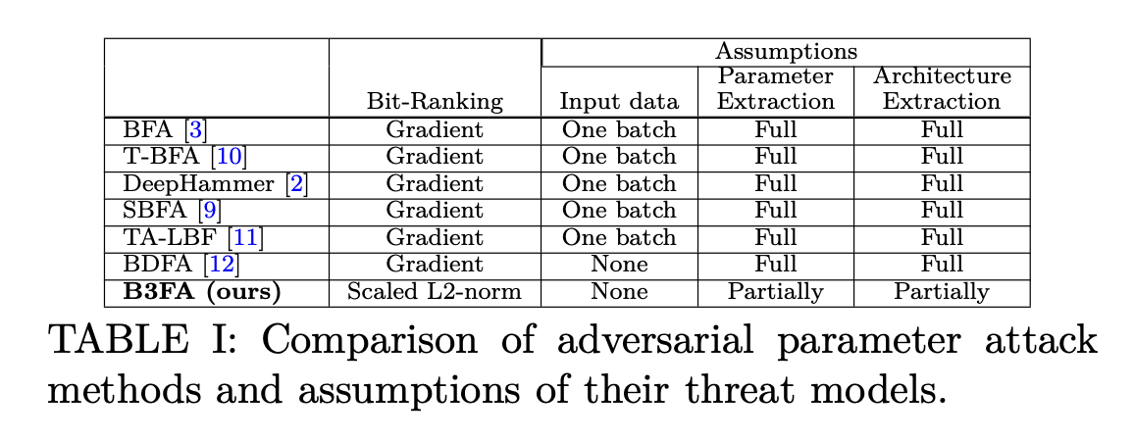

Slide 2
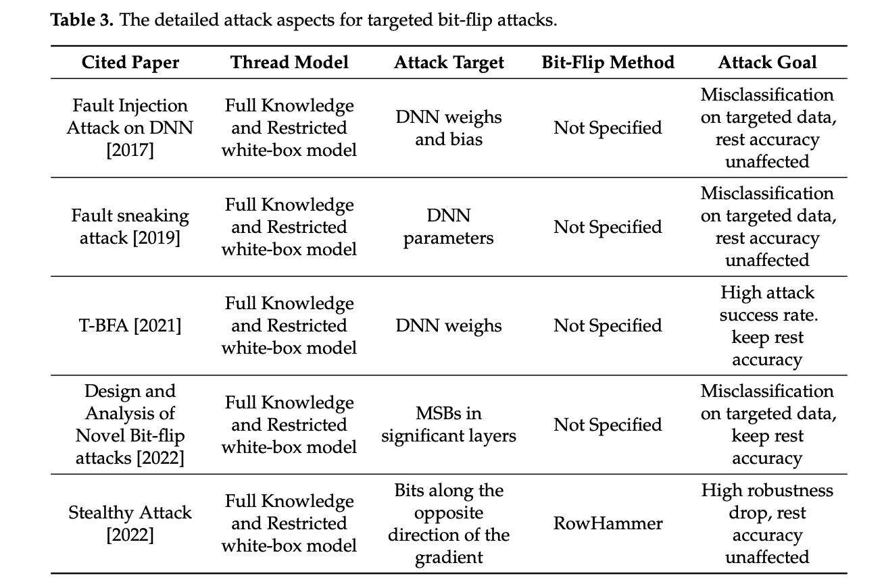

Slide 3
T-BFA: Targeted Bit-Flip Adversarial
Weight Attack (2021)
Adnan Siraj Rakin et al.
Presenter: Amirmohammad Pournaghshband

Slide 4
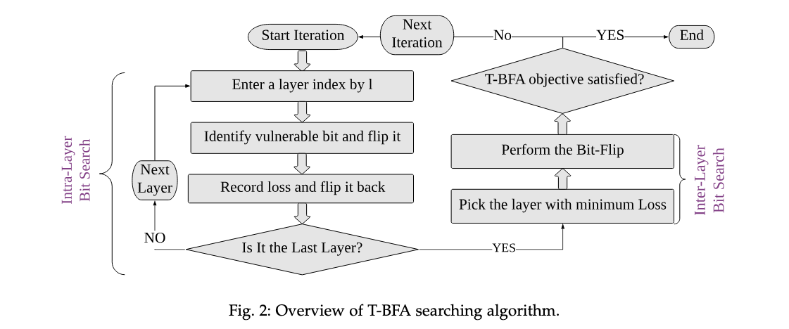
T-BFA Methodology
Vulnerable bit finding
Intra-layer: Identifying the weight-bit with the highest gradient and flipping along the direction of bit-gradient
By performing a gradient-based search
For every bit in the quantized weights of a given layer, compute the gradient of the targeted attack loss with respect to that bit.
This gives a measure of how much the loss would change if that bit were flipped.
Inter-layer: the inter-layer search performs straight-forward comparison to identify the winner weight-bit candidate with minimal profiled loss as the weight-bit to attack in iteration $k$

Slide 5
DeepHammer: Depleting the Intelligence of Deep Neural Networks through Targeted Chain of Bit Flips (2020)
Fan Yao, Adnan Siraj Rakin, Deliang Fan

Slide 6
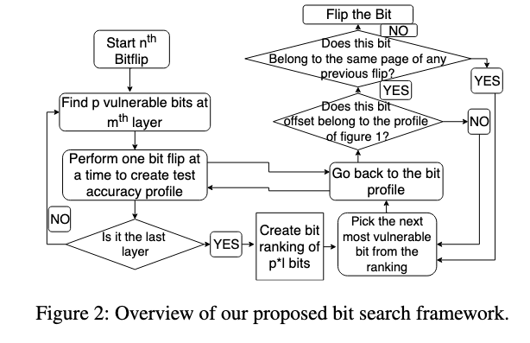
Methodology
Gradient-based bit ranking (GBR): In this step, we create a ranking of most vulnerable bits in the network based on its gradient values
Flip-aware bit search (FBS): In this step, we perform flip-aware bit search to discover a chain of bit flips that can degrade the inference accuracy to the desired level on the target hardware platform

Slide 7
Targeted Attack Against Deep Neural Networks via Flipping Limited Weight Bits (2021)
Jiawang Bai et al.

Slide 8
Methodology
Efficient (targeted) and stealthy
This method identifies vulnerable bits to flip by formulating the attack as an optimization problem rather than relying on simple heuristics or exhaustive search.
During optimization, the algorithm determines which bits, if flipped, will most effectively increase the logit of the target class and decrease the logit of the true class for the chosen sample, while affecting other samples as little as possible.
Instead of flipping bits at random or by heuristic importance, the method uses mathematical optimization to systematically and efficiently identify the set of bits whose modification will best achieve the desired attack effect with minimal collateral damage to overall model accuracy.

Slide 9
Blind Data Adversarial Bit-flip Attack against Deep Neural
Networks (2022)
Behnam Ghavami et al.

Slide 10
Introduction
Previous attacks rely on flipping a small number of bits in DNN weights, but they assume access to training/testing data — often unavailable in sensitive settings.
Motivation: Many applications (e.g., in healthcare) don’t allow data access due to privacy and regulatory restrictions. There is a need for attacks that do not require any data — “blind” attacks.
Contribution:
Introduced the first Blind Data Bit-Flip Attack (BDFA) — performs parameter attacks without access to any real data.
Synthetic Data Generation: Input normalization, Batch normalization statistics, Targeted output label
Achieve similar or better performance than white-box BFA

Slide 11
Methodology
Bit-Flip Attack (BFA):
Uses gradients to rank parameter bits for flipping
Requires real input/output data
Blind Data Bit-Flip Attack (BDFA):
Synthetic Data Generation:
Input Normalization: Start with random data, normalized (mean=0, std=1)
BatchNorm Statistics: Optimize synthetic data to match BN layer stats (mean & std)
Label Similarity: Randomly assign labels and backpropagate to minimize model loss

Slide 12
A Semi Black-Box Adversarial Bit-Flip Attack with Limited
DNN Model Information (2024)
Behnam Ghavami et al.

Slide 13
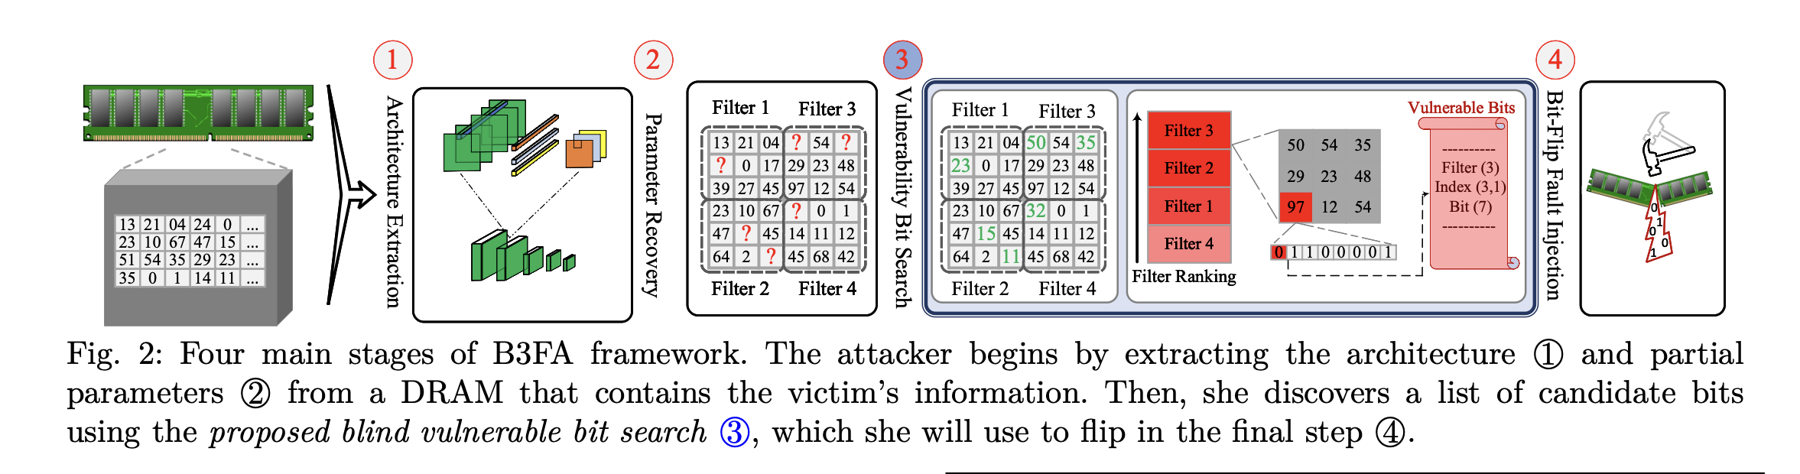
Methodology
Architecture Extraction: Uses cache side-channel attacks (e.g., Flush+Reload) to extract layer structure.

Slide 14
Methodology
Partial Parameter Recovery:
Applies double-sided rowhammer attacks to recover a portion of weights.

Slide 15
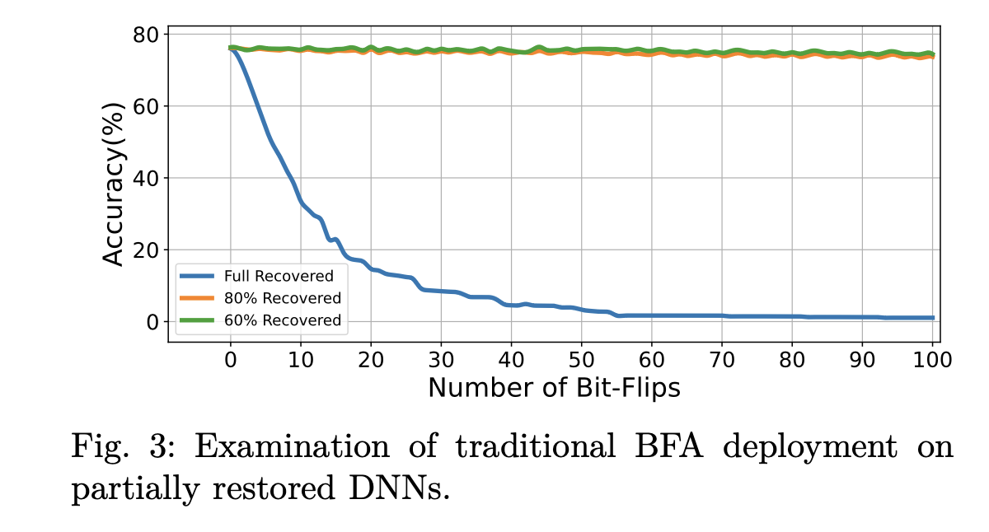
Methodology
Issue 1:
Conventional BFAs need full parameter information to
compute loss gradients and locate vulnerable weight bits.
Issue 2: Gradient computation requires a portion of the
training/inference dataset, which is inaccessible in a real
threat model.

Slide 16
Methodology
Vulnerable Bit Search:
Uses Normalized Filter-wise L2-norm Ranking (FL2R) to find critical bits.
Extended with Closer-to-Zero Reconstruction (CZR) for missing values.

Slide 17
Methodology
FL2R (Filter-wise L2-Norm Ranking)
A data-free method to find vulnerable bits in a DNN.
Calculates the normalized L2-norm (magnitude) of each filter’s weights.
Assumes filters with larger L2-norms contribute more to the model’s output.
Ranks filters by importance, then identifies and flips the most significant bit of the largest weights to cause maximum damage.
CZR (Closer to Zero Reconstruction)
A method to estimate missing weight bits in partially recovered models.
Based on the observation that most DNN weights are close to zero.
Predicts unknown bits to make weights as small (close to zero) as possible.
Improves the reliability of FL2R when full parameter values aren’t available.

Slide 18
Methodology
Bit-Flip Injection:
Performs targeted bit-flips using rowhammer in memory to corrupt model behavior.

Slide 19
Related Papers
HyperTheft: Thieving Model Weights (2024)
GPUHammer: Rowhammer Attacks on GPU (2025)

